Slide 2
Overview
Part1 - Introduction
Design Topics
Design hierarchy
Design Procedure
The major design steps: specification, formulation, optimization, technology mapping, and verification
Technology Mapping
From AND, OR, and NOT to other gate types
Decoders
Part 2
Encoders
Multiplexers
Binary Adders

Slide 3
Combinational Circuits
A combinational logic circuit has:
A set of m Boolean inputs,
A set of n Boolean outputs, and
n switching functions, each mapping the 2^{m} input combinations to an output such that the current output depends only on the current input values
A block diagram:
Combinatorial
Logic
Circuit
m Boolean Inputs
n Boolean Outputs

Slide 4
Decoding
Decoding - the conversion of an n-bit input code to an m-bit output code with n ≤ m ≤ 2^{n} such that each valid code word produces a unique output code
Circuits that perform decoding are called decoders
Here, functional blocks for decoding are
called n-to-m line decoders, where m ≤ 2^{n}, and
generate 2^{n} (or fewer) minterms for the n input variables

Slide 5
Decoder Examples
1-to-2-Line Decoder
2-to-4-Line Decoder
Note that the 2-4-line made up of 2 1-to-2- line decoders and 4 AND gates.

Slide 6
Decoder with Enable
In general, attach m-enabling circuits to the outputs
See truth table below for function
Note use of X’s to denote both 0 and 1
Combination containing two X’s represent four binary combinations
Alternatively, can be viewed as distributing value of signal EN to 1 of 4 outputs
In this case, called a demultiplexer

Slide 7
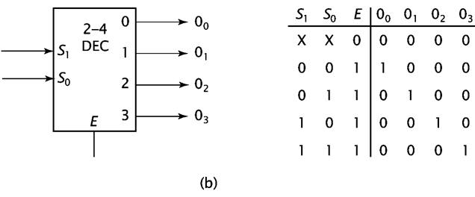
2-to-4 Decoder Diagram

Slide 8
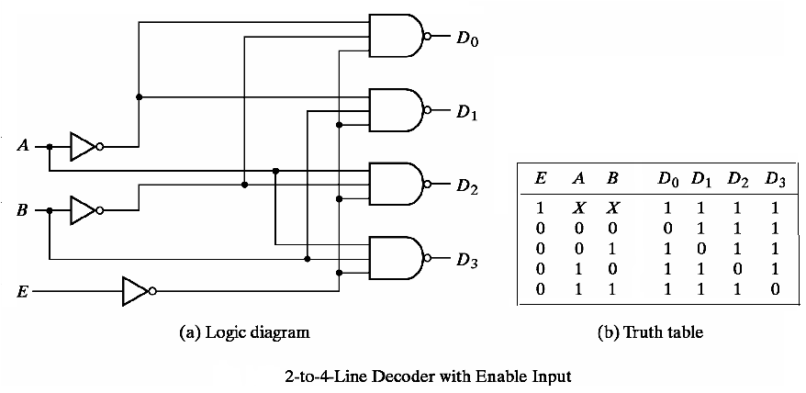
NAND Only

Slide 9
Decoder Expansion
General procedure given in book for any decoder with n inputs and 2^{n} outputs.
This procedure builds a decoder backward from the outputs.
The output AND gates are driven by two decoders with their numbers of inputs either equal or differing by 1.
These decoders are then designed using the same procedure until 2-to-1-line decoders are reached.
The procedure can be modified to apply to decoders with the number of outputs ≠ 2^{n}

Slide 10
3-to-8-line decoder (without enable)
Consider a 3-to-8-line decoder (without enabler)
A2 | A1 | A0 | D0 | D1 | D2 | D3 | D4 | D5 | D6 | D7
0 | 0 | 0 | 1
0 | 0 | 1 |  | 1
0 | 1 | 0 |  |  | 1
0 | 1 | 1 |  |  |  | 1
1 | 0 | 0 |  |  |  |  | 1
1 | 0 | 1 |  |  |  |  |  | 1
1 | 1 | 0 |  |  |  |  |  |  | 1
1 | 1 | 1 |  |  |  |  |  |  |  | 1

Slide 11
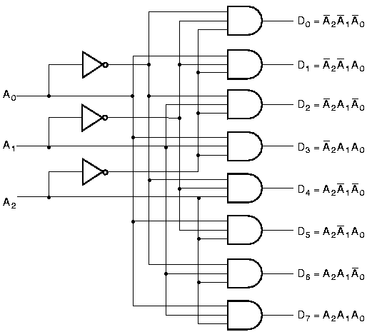
3-to-8-line Decoder Implementation

Slide 12
Easier way by Expansion
Decoder expansion
Combine two or more small decoders with enable inputs to form a larger decoder
3-to-8-line decoder constructed from two 2-to-4-line decoders
The MSB is connected to the enable inputs
if A₂=0, upper is enabled; if A₂=1, lower is enabled.

Slide 13
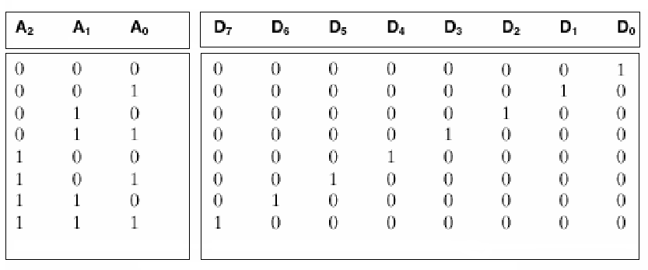
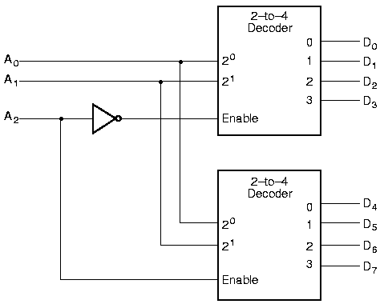
Expansion

Slide 14
Combinational Circuit Design with Decoders
Combinational circuit implementation with decoders
A decoder provide 2^{n} minterms of n input variables
Since any Boolean function can be expressed as a sum of minterms, one can use a decoder and external OR gates to implement any combinational function.

Slide 15
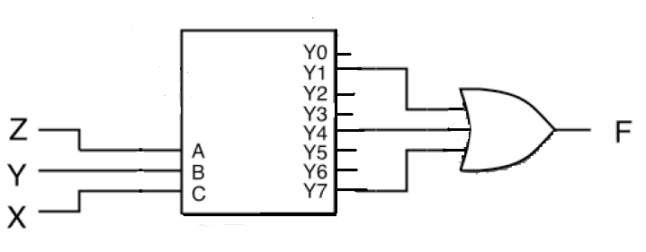
Combinational Circuit Design with Decoders
Realize F (X,Y,Z) = Σ (1, 4, 7) with a decoder:

Slide 16
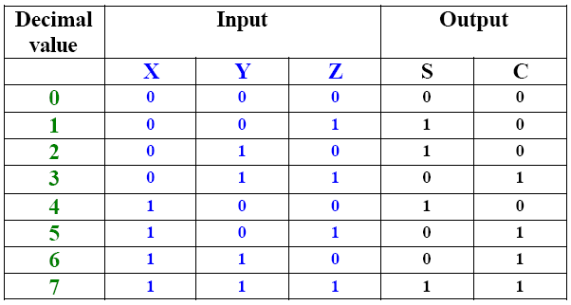
Decoder Implementation of a Full Adder
Truth Table: We have two outputs, called S, which stands for sum, and C, which stands for carry. Both sum and carry are functions of X, Y, and Z.

Slide 17

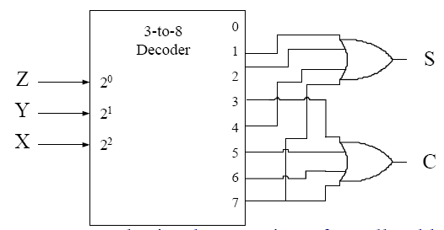
Decoder Implementation of a Full Adder
The output functions S & C can be expressed in sum-of-minterms forms as follows:
S is implemented by taking minterms 1, 2, 4, and 7 and the OR gates forms the logical sum of minterm for S
Similarly, carry C is implemented by taking logical sum of minterms 3, 5, 6, and 7 from the same decoder

Slide 18
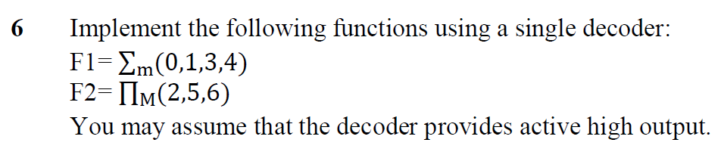
Spring 2024 Question 6

Slide 19
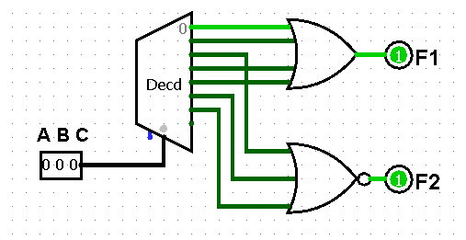
Spring 2024 Question 6

Slide 20
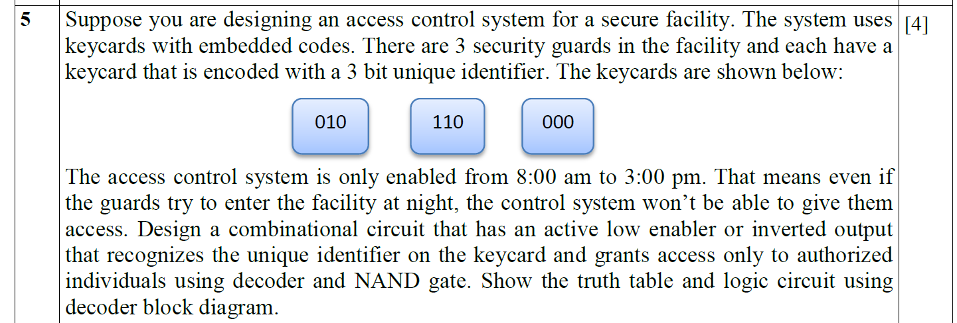
Fall 2023 Question 5

Slide 21
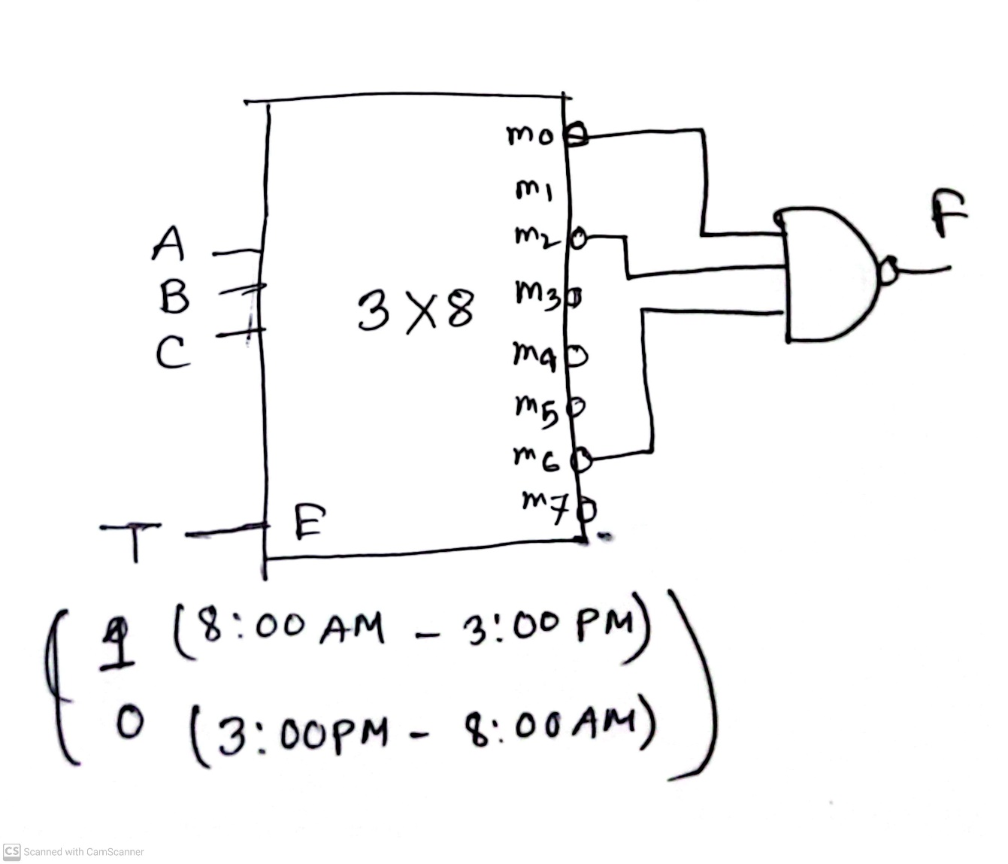
Fall 2023 Question 5

Slide 22
Thank You

